Slide 1

Data Tables
Principles of Web Design

Slide 2
Objectives
When you complete this chapter, you will be able to:
Use table elements
Use table headers and footers
Group columns
Style table borders
Apply padding, margins, and floats to tables
Style table background colors
Apply table styles

Slide 3
Using Table Elements
The HTML table elements allow the arrangement of data into rows of cells and columns
The table element <table> contains the table information, which consists of:
Header element <th>
Row element <tr>
Data cell alignment <td>

Slide 4
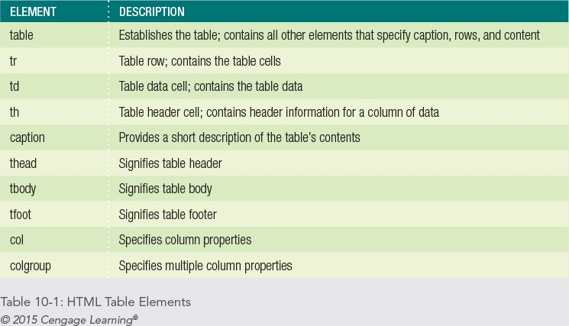

Slide 5
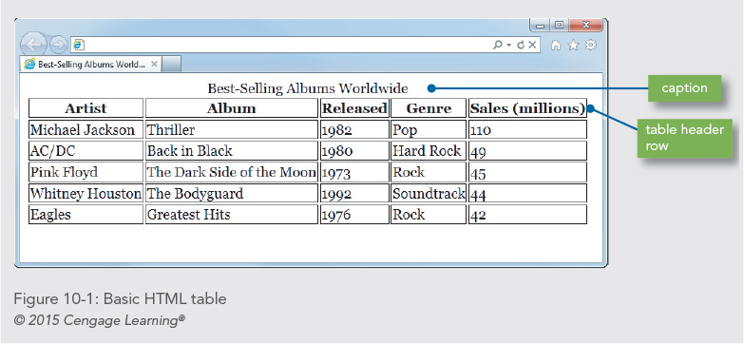

Slide 6
Collapsing Table Borders
Tables are more legible with the table borders collapsed
Use the border-collapsed property
table {border-collapse: collapse;}

Slide 7
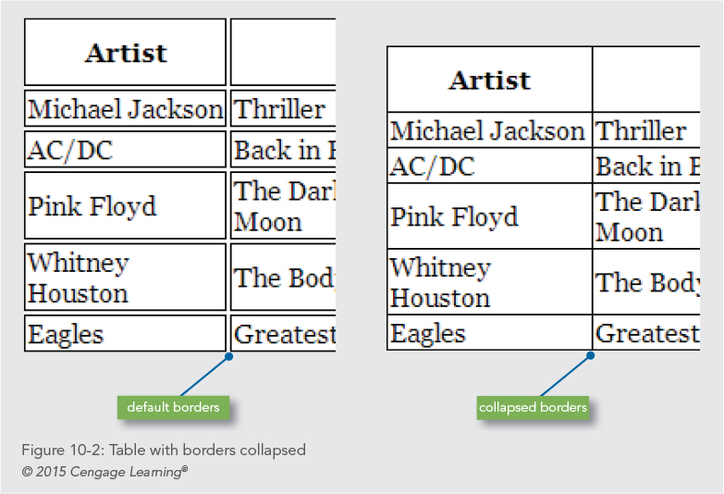

Slide 8
Spanning Columns
The colspan attribute lets you create cells that span multiple columns
<td class="title" colspan=“5">
Best-Selling Albums Worldwide</td>

Slide 9
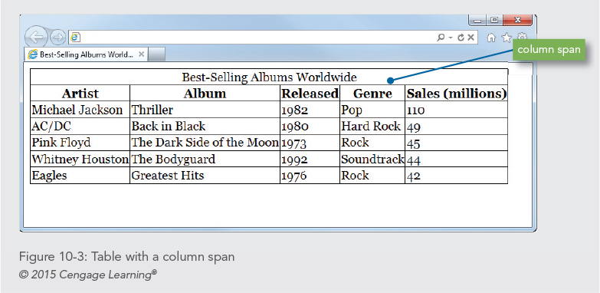

Slide 10
Spanning Rows
The rowspan attribute lets you create cells that span multiple rows
<td class="title" rowspan="6">
Best-Selling Albums Worldwide</td>

Slide 11
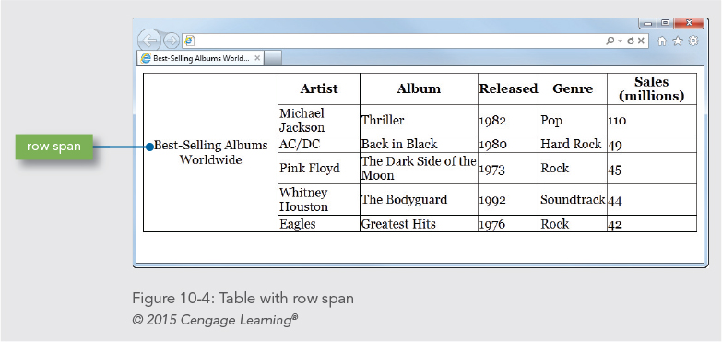

Slide 12
Using Table Headers and Footers

Slide 13
Using Table Headers and Footers
Rows can be grouped into head, body, and footer sections using the <thead>, <tbody>, and <tfoot> elements
You can style these table sections with CSS

Slide 14
Using Table Headers and Footers
thead {
font-family: arial;
background-color: #ccddee;
}
tfoot {
background-color: #ddccee;
font-family: times, serif;
font-size: .9em;
font-style: italic;
}

Slide 15
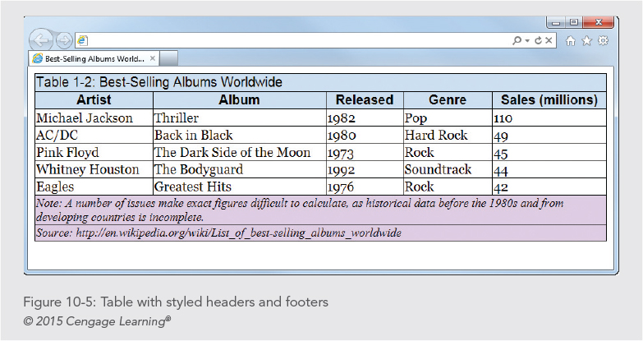

Slide 16
Grouping Columns

Slide 17
Grouping Columns
The <colgroup> and <col> elements allow you to apply style characteristics to groups of columns or individual columns
The <colgroup> element has a span attribute that lets you set the number of columns specified in the group
The <col> element lets you specify style characteristics for individual columns

Slide 18
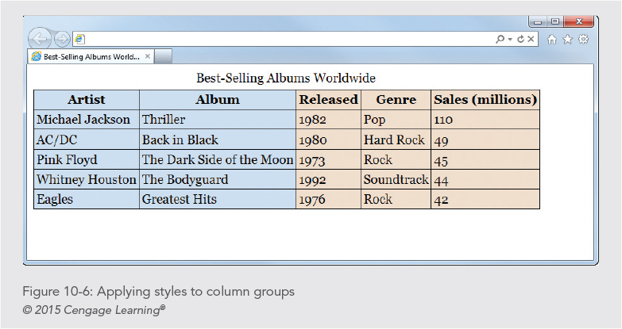

Slide 19
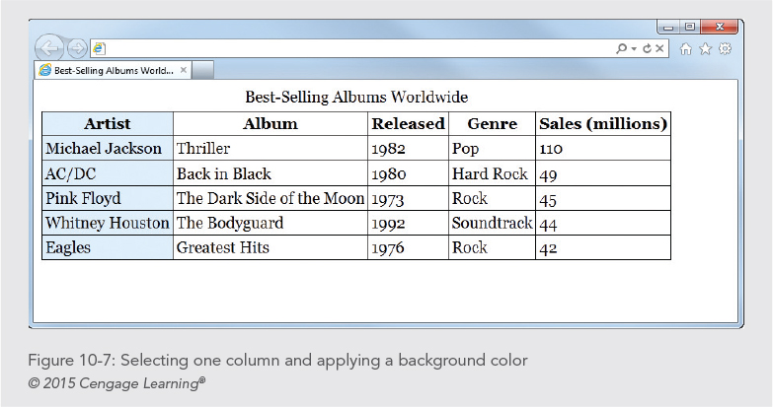

Slide 20
Styling the Caption
You can position the caption on the top or bottom of the table using the caption-site property
You can also apply other style properties to enhance the caption text:
caption {text-align: left;
font-style: italic;
padding-bottom: 10px;
}

Slide 21
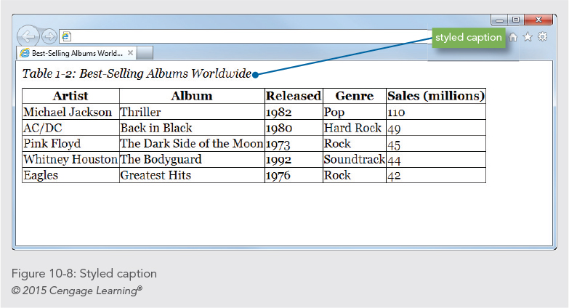

Slide 22
Styling Table Borders

Slide 23
Styling Table Borders
By default, table borders are turned off
You can add borders using CSS
Borders can be applied to the whole table, to individual rows, and to individual cells

Slide 24
Styling Table Borders
To create a table with an outside border only:
table {
border: solid 1px black;
border-collapse: collapse;
}

Slide 25
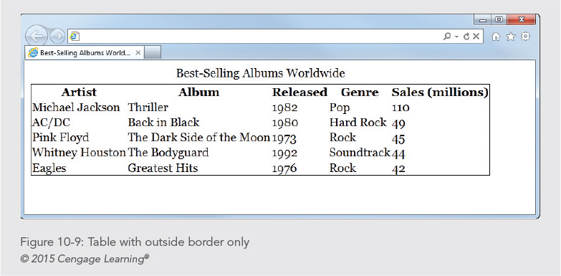

Slide 26
Styling Table Borders
To specify borders for each cell, use a separate style rule:
table {
border: solid 1px black;
border-collapse: collapse;
}
th, td {
border: solid 1px black;
}

Slide 27
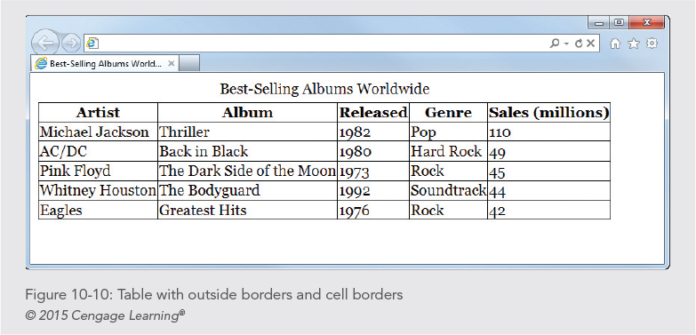

Slide 28
Styling Table Borders
You can also style individual rows or cells and apply cell borders
th {
border-bottom: solid thick blue;
background-color: #ccddee;
}

Slide 29
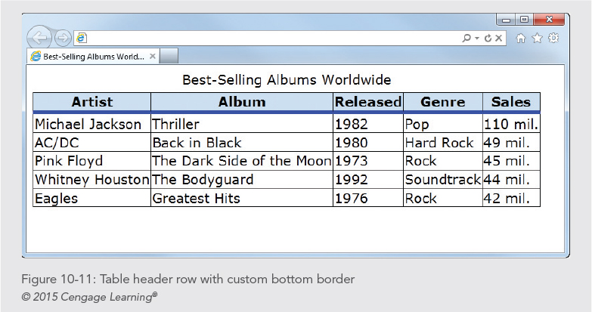

Slide 30
Applying Padding, Margins, and Floats to Tables

Slide 31
Using Padding
You can enhance the legibility of your table data with padding
This style rule adds five pixels of padding to both types of table data elements
th, td {padding: 5px;}

Slide 32
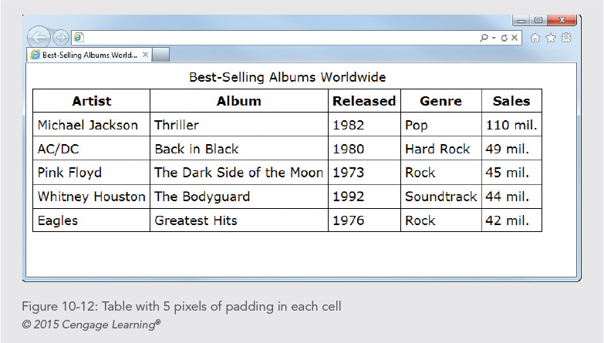

Slide 33
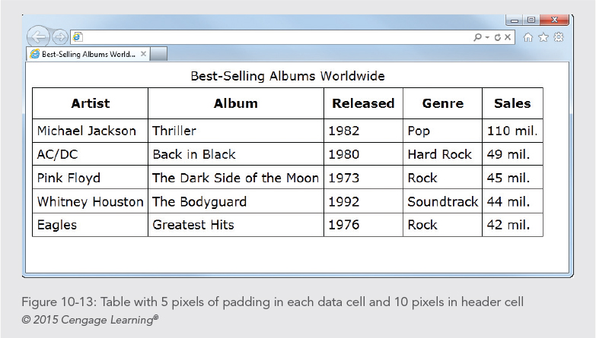

Slide 34
Using Margins and Floats
Tables can be floated
Use margins to add white space around floating tables
table.best {
font-family: verdana;
border: solid 1px black;
border-collapse: collapse;
float: left;
margin-right: 20px;
margin-bottom: 10px;
}

Slide 35
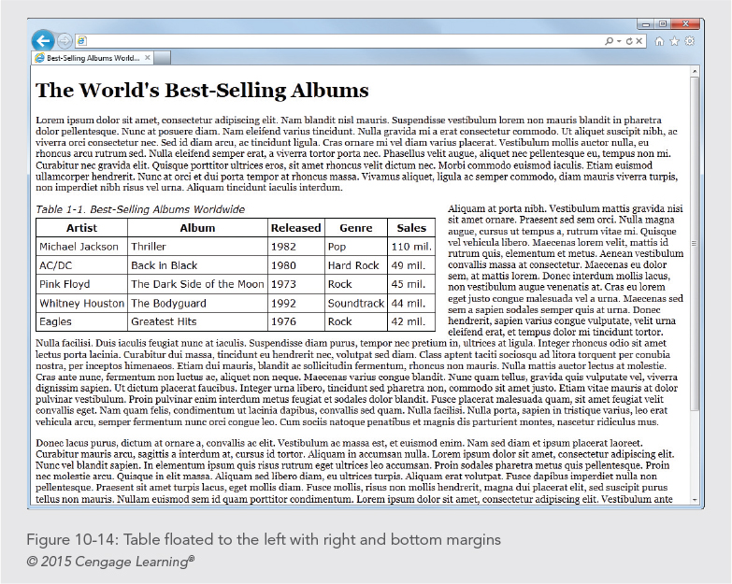

Slide 36
Styling Table Background Colors

Slide 37
Styling Table Background Colors
You can apply background colors to:
Entire table
Single rows or cells
Column groups of individual columns
You can alternate colors for different rows
Add hover interactions

Slide 38
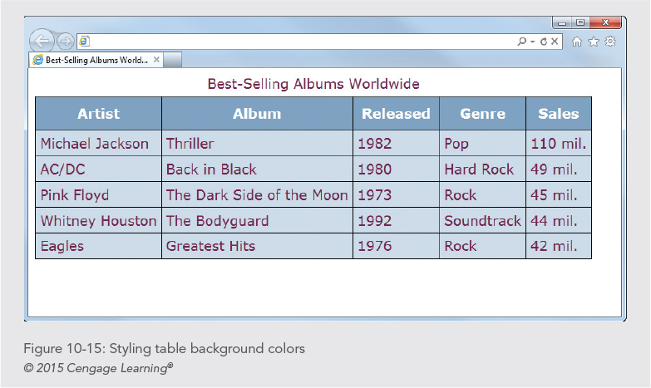

Slide 39
Creating Alternate Color Rows
Table data is easier to read when alternate rows have a distinguishing background color
Write a style rule for the odd or even row using a class selector
tr.odd td {background-color: #eaead5;}

Slide 40
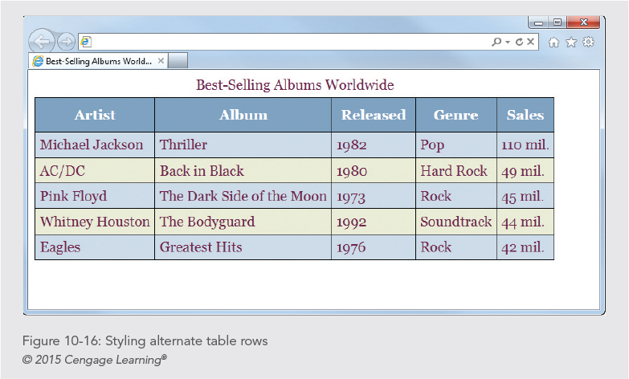

Slide 41
Creating Background Hover Effects
You can add interactivity to your table with hover effects
When the user hovers the pointer over a cell or row, the formatting can change
td:hover {
color: white;
background-color: #722750;
}

Slide 42
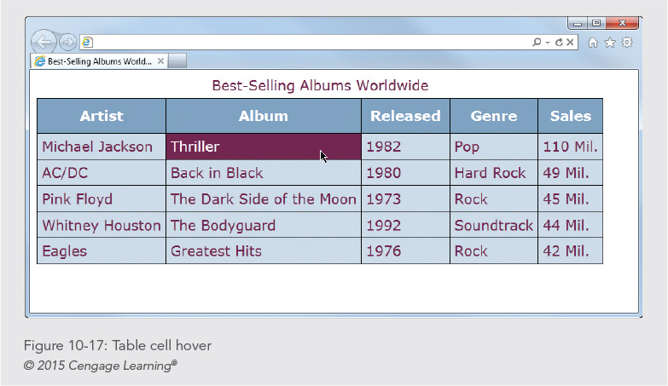

Slide 43
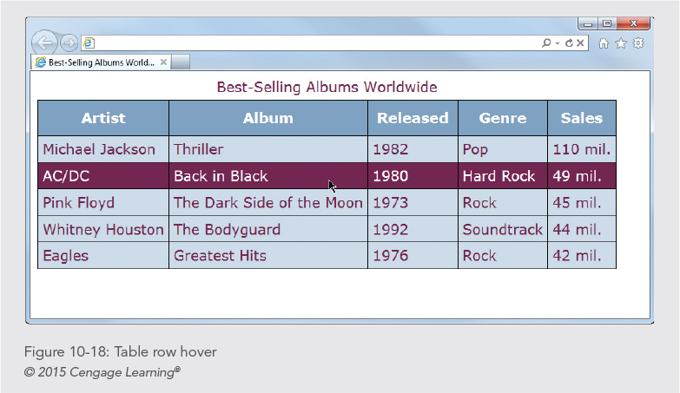

Slide 44
Summary
Use tables for presentation of data, not for page layout
Use the grouping elements to apply styles to groups of rows or columns or to the header, body, and footer of a table
Apply borders to both the <table> and cell (<th> and <td>) elements to display a table border on the entire table
Use the border-collapse property to make table data more legible

Slide 45
Summary
Always use CSS to add presentation style to tables
Use padding to add space within your cells to make your data more legible
You can float tables and add margins with the box model properties
Specify background colors or hovers to aid in the legibility of your data

